Slide 1


Unravelling the Veil of Despair: A Comprehensive Data Visualization Project on Suicides in India.

Slide 2
Author
Sai Teja Rayabarapu (Student ID: 11637122)
SaiTejaRayabarapu@my.unt.edu
Major: Information Science

Slide 3

Reason for choosing this topic
Social Significance
Data Availability
Identifying Risk Factors
Advocacy and Awareness

Slide 4

Problem Statement
Analyzing and Visualizing Suicides in India to Uncover Patterns, Risk Factors, and Regional Variations for Informed Mental Health Interventions
Description
The problem aims to explore and visualize the suicide data in India over the past decade to gain deeper insights into the prevalence, trends, and potential risk factors associated with suicides. The project seeks to create meaningful data visualizations that highlight the regional variations, demographic profiles, and correlations between various factors and suicide rates.

Slide 5
Dataset
Source: Kaggle
Link: https://www.kaggle.com/datasets/rajanand/suicides-in-india

Slide 6
HYPOTHESIS
The suicide rate among young adults (age group 15-29) in India has increased over the years from 2001 to 2012.
There is a significant difference in suicide rates between genders in India, with a higher rate among males compared to females.
Certain states in India show higher suicide rates compared to others, indicating a regional variation in suicide prevalence.
Married people committed more suicides than other type of people.

Slide 7
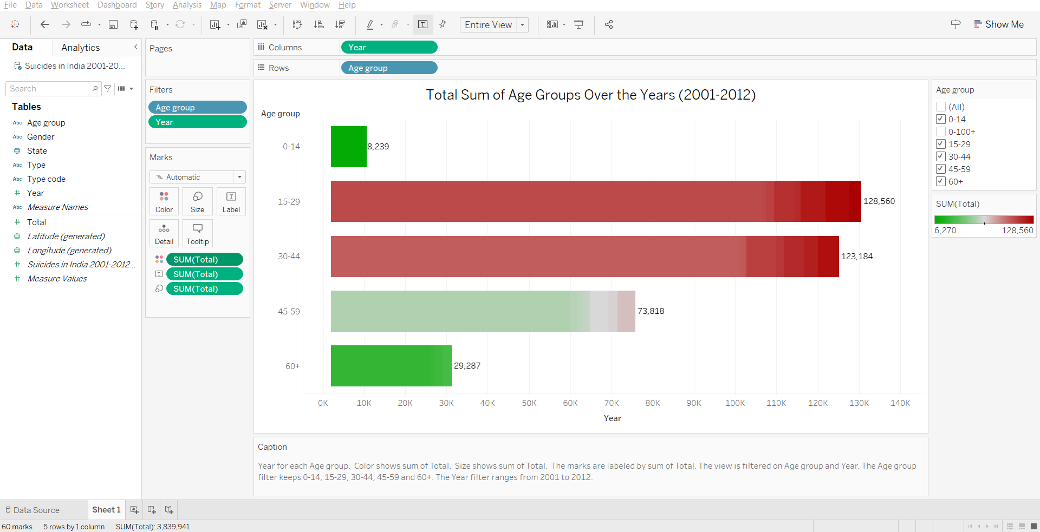
The suicide rate among young adults (age group 15-29) in India has increased over the years from 2001 to 2012.

Slide 8
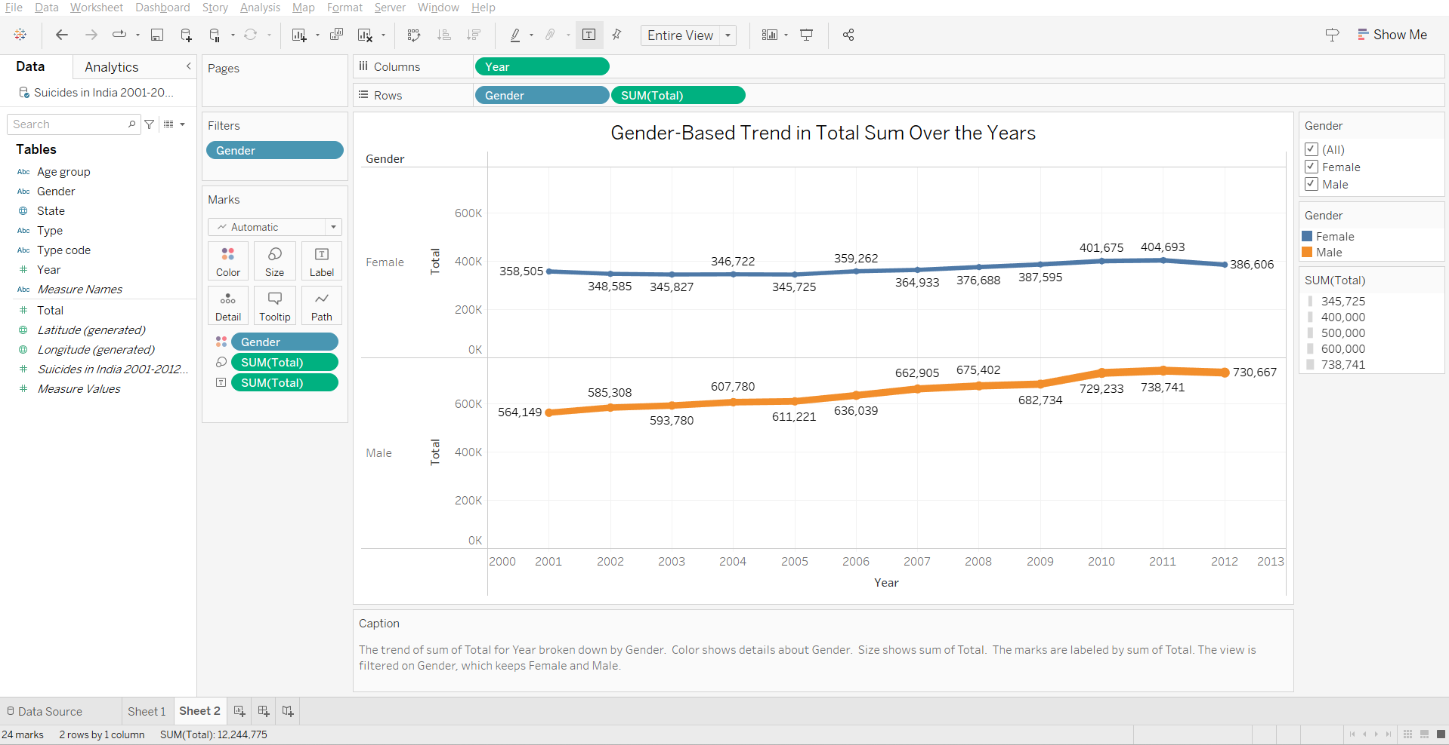
There is a significant difference in suicide rates between genders in India, with a higher rate among males compared to females.

Slide 9
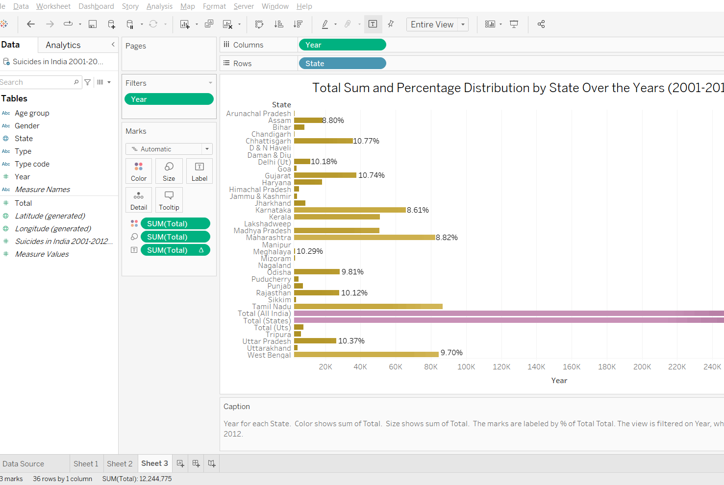
Certain states in India show higher suicide rates compared to others, indicating a regional variation in suicide prevalence.

Slide 10
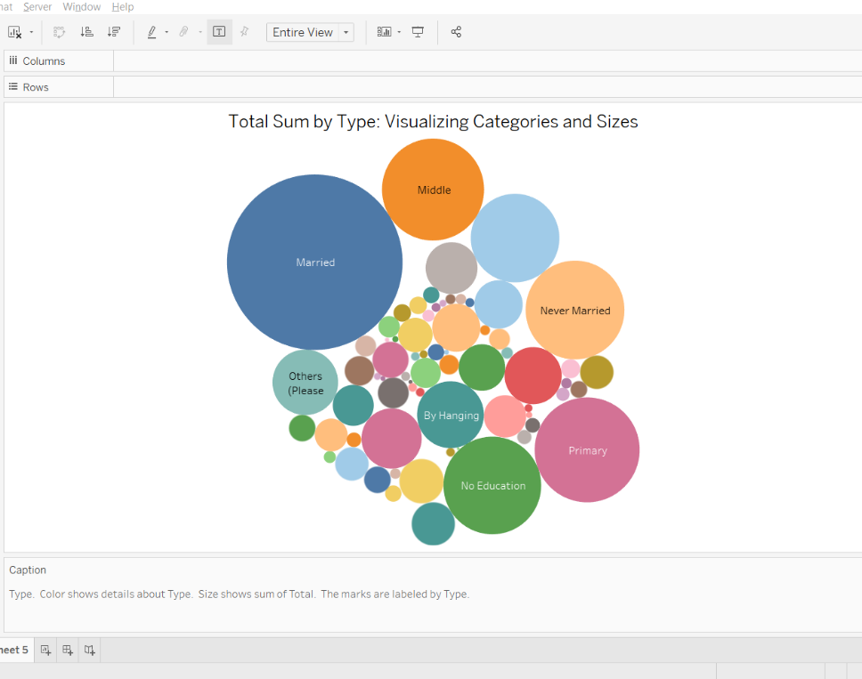
Married people committed more suicides than other type of people.

Slide 11
QUESTIONS
Is the Suicide rate Increasing Every year from 2001 to 2012?
What are the top 10 states with the highest number of Suicides in India?
What are the major causes for maximum suicides?
Which part of India has less number of suicides?
Does education assist with self-control and wisdom, which will aid in the prevention of suicides?

Slide 12
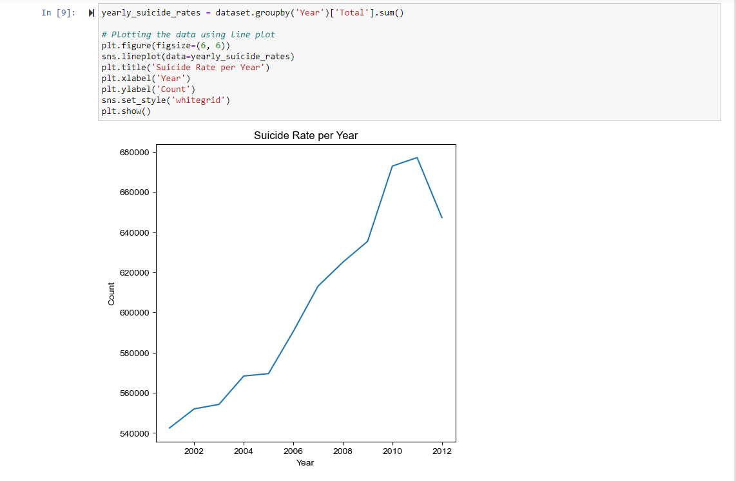
Is the Suicide rate Increasing Every year from 2001 to 2012?

Slide 13
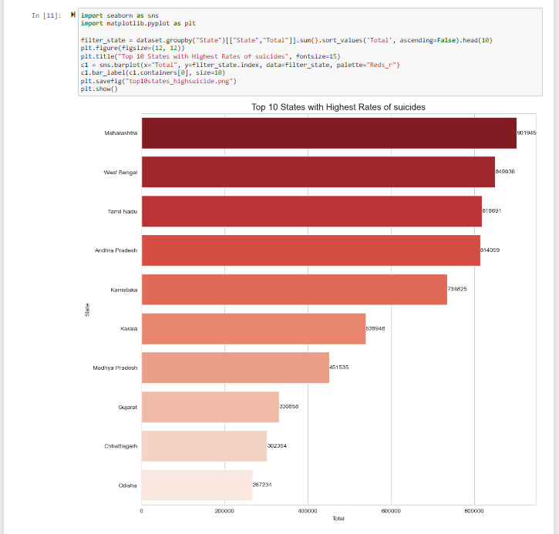
What are the top 10 states with the highest number of Suicides in India?

Slide 14
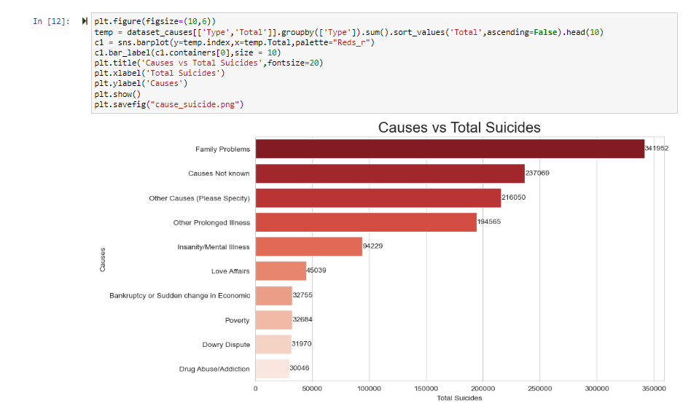
What are the major causes for maximum suicides?

Slide 15
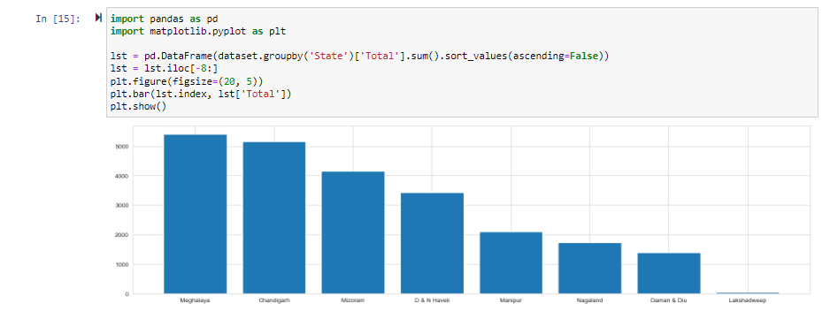
Which part of India has less number of suicides?

Slide 16
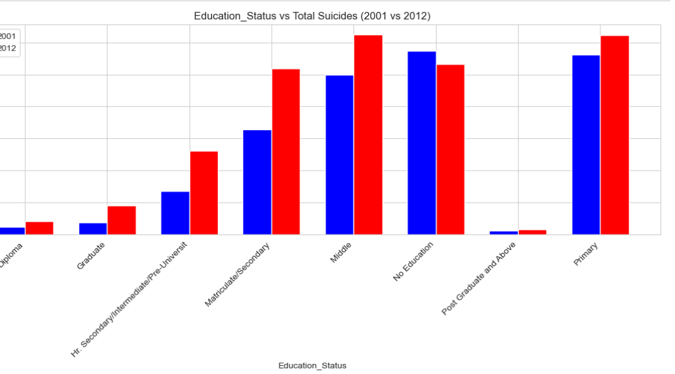
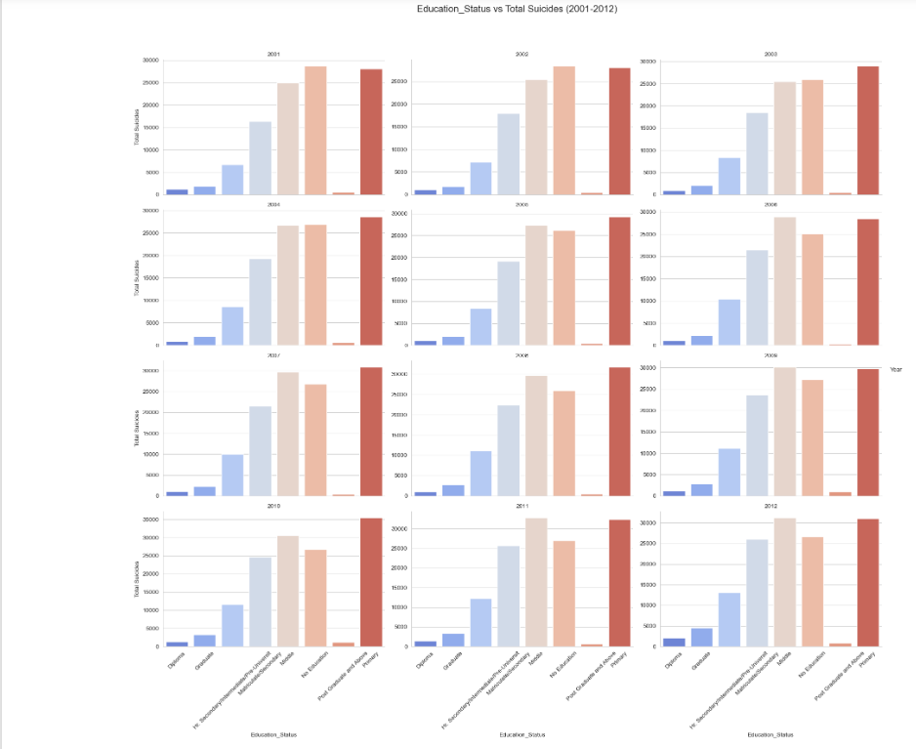
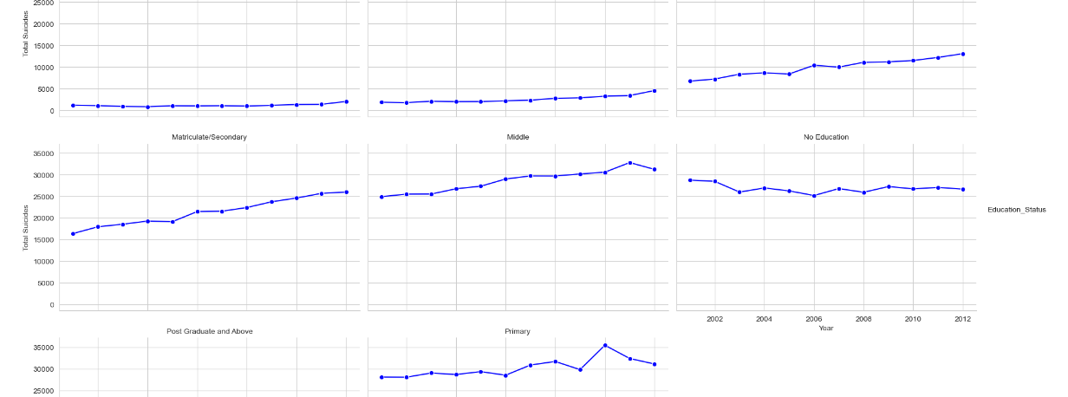
Does education assist with self-control and wisdom, which will aid in the prevention of suicides

Slide 17
Conclusion
This project analyzed and visualized several comparisons, proving the different hypotheses on people committing suicide in India. It includes many factors which are impacting people to die. This analysis can be useful for government officials and psychologists to understand the patterns and comparisons of people's acts and deal with them accordingly. The "Suicides in India" data visualization project provides useful insights into the scope and intricacies of the issue. We presented the data in a clear and readily comprehensible manner utilizing multiple visualization tools, helping stakeholders to make educated decisions and plan focused actions. This initiative seeks to improve public awareness about suicide as a public health issue and to help efforts to reduce suicide rates in India.

Slide 18

Thank you

